Slide 1
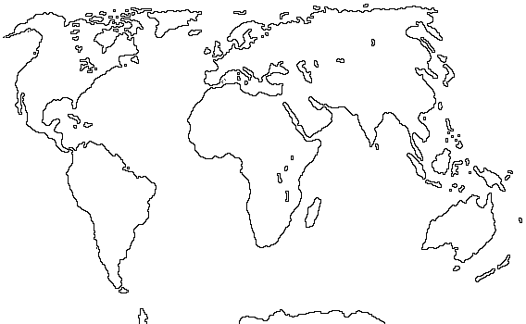
MY RACE, OUR RACE: OUR RACE!!!!

Slide 2
